Slide 1


Supply Chain Analysis

Slide 2
Meet your Analysis wizards
Radwa Nasser Mostafa
Mahmoud Emad Mohamed
Sherif Saied Abdelraheem
Alaa Ahmed Mahmoud
2

Slide 3
Table Of Contents
How to make the Supply Sense?
What is our goal ?
How did we clean the Data ?
What is our analysis?
What is our Insights ?
How did we visualize ?
3

Slide 4
How to make the Supply Sense?
Problem in hand:
Delays in supply chains disrupt customer satisfaction and operational efficiency, leading to financial losses and missed opportunities.
Proposed Solution: We utilize data-driven analytics to predict delivery delays reasons by analyzing historical shipment dates, shipping modes, customer segments, and geographic locations.
Unique Value Proposition: Our approach integrates advanced analysis with visual insights and dashboards, enabling proactive measures to reduce delay risks, optimize shipping routes, and enhance customer satisfaction.

Slide 5

What is our goals ?
Improve Delivery Times: Identify regions and markets with high delivery delays and optimize shipping strategies.
Enhance Customer Satisfaction: Analyze customer segments, shipping modes, and their impact on retention and loyalty.
Detect Fraud and Cancellations: Utilize customer segmentation to predict and reduce fraudulent activities and cancellations.
Optimize Profitability: Explore high-profit products and shipping modes to maximize overall profitability.
Data-Driven Decisions: Create dashboards and insights that empower management to take real-time decisions and improve supply chain performance.
Forecast Future Delay: predict late deliveries and returns based on data.

Slide 6

How did we clean the Data ?

Slide 7
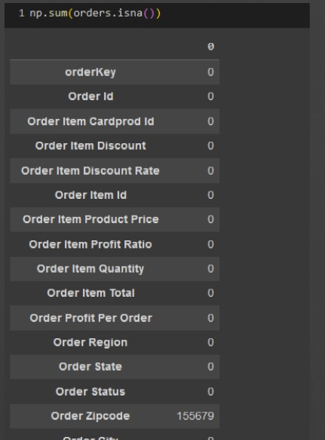
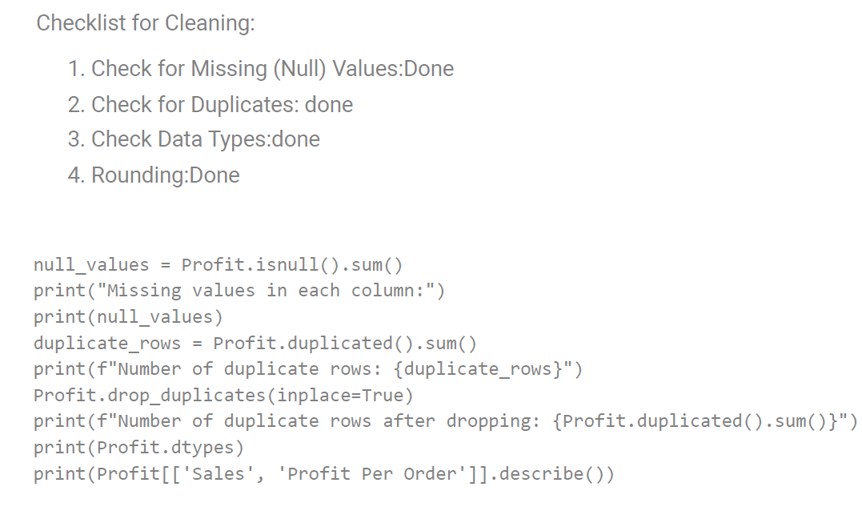


Data Cleaning with Python
Performed data cleaning using Python to prepare the dataset for analysis.
Removed nulls in and dropped unnecessary columns and duplicated columns as well like Product Description and Order Zipcode

Slide 8
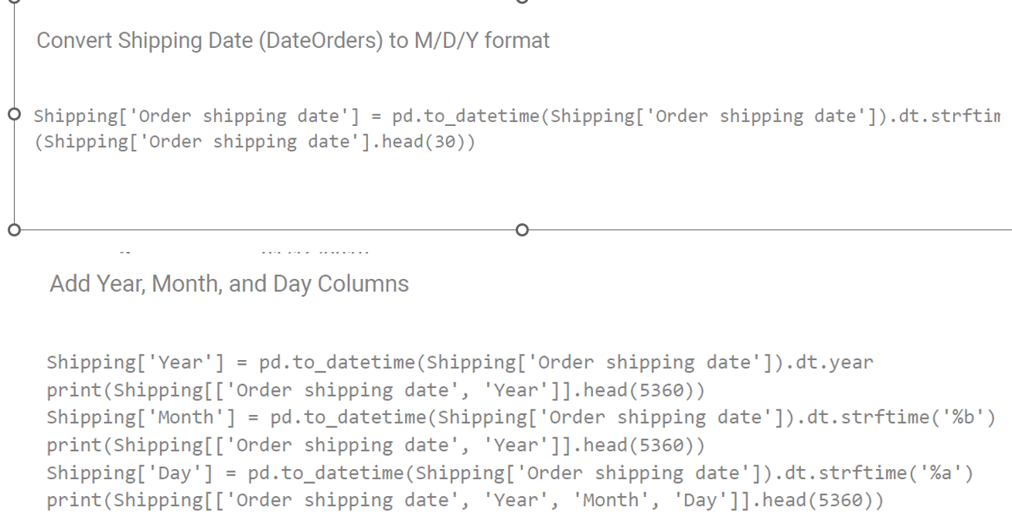
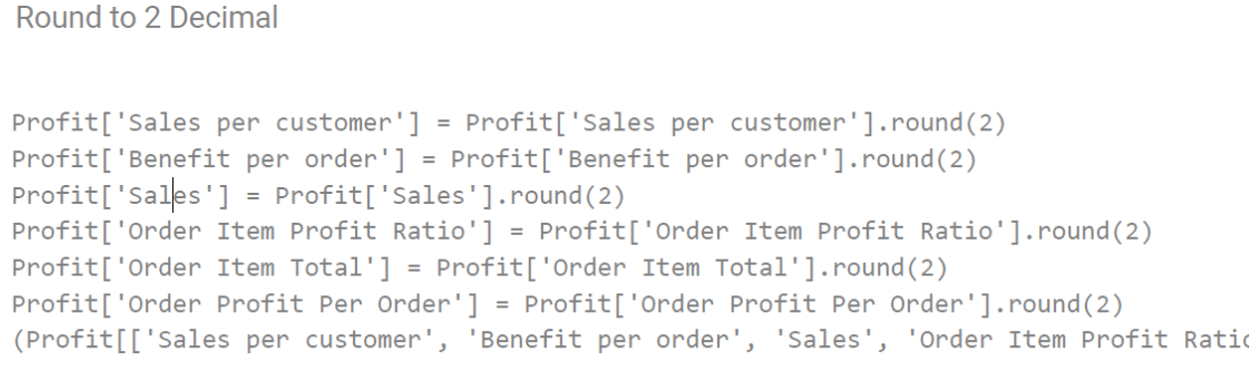
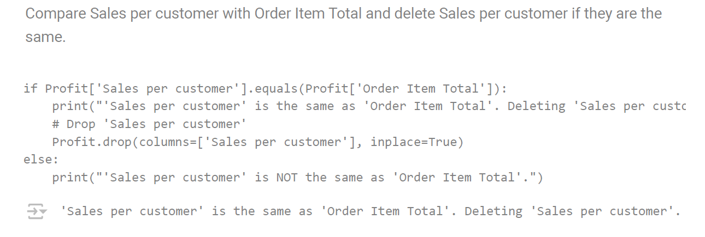
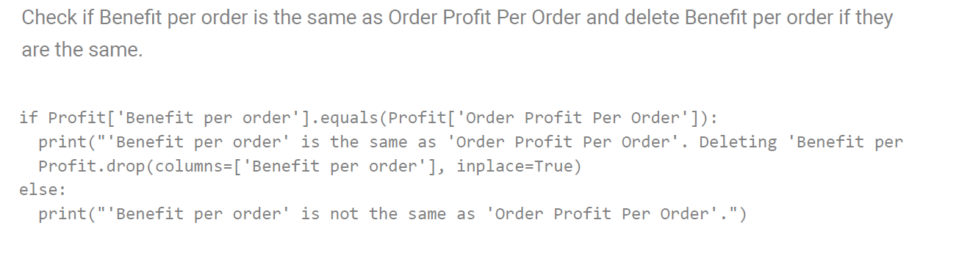








Data Cleaning with Python
Round the numbers and fixed the dates and added Year and Month and day column

Slide 9
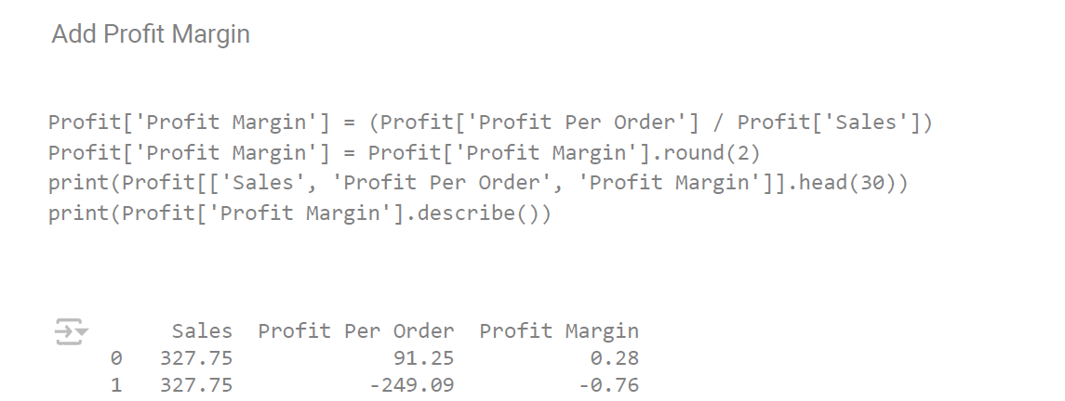
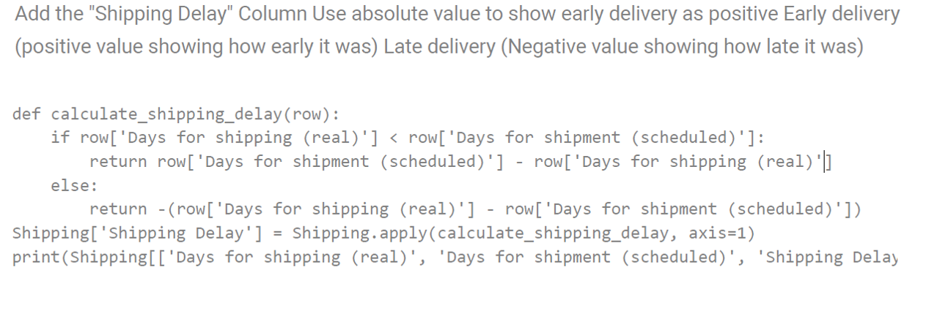
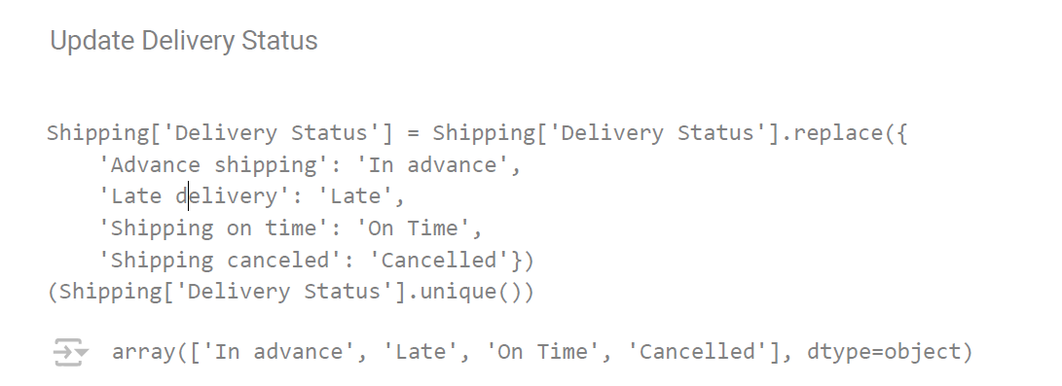
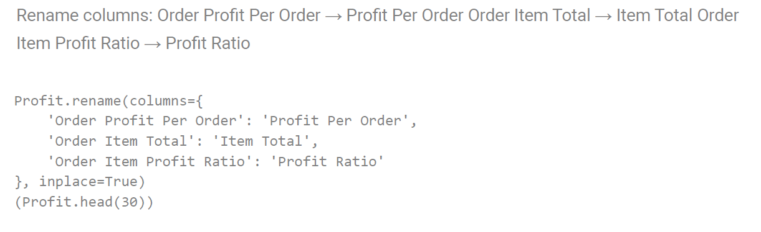





Add it shipping Delay column and profit margin to help in analysis and renaming columns to more convenient names

Slide 10

What is our analysis?

Slide 11
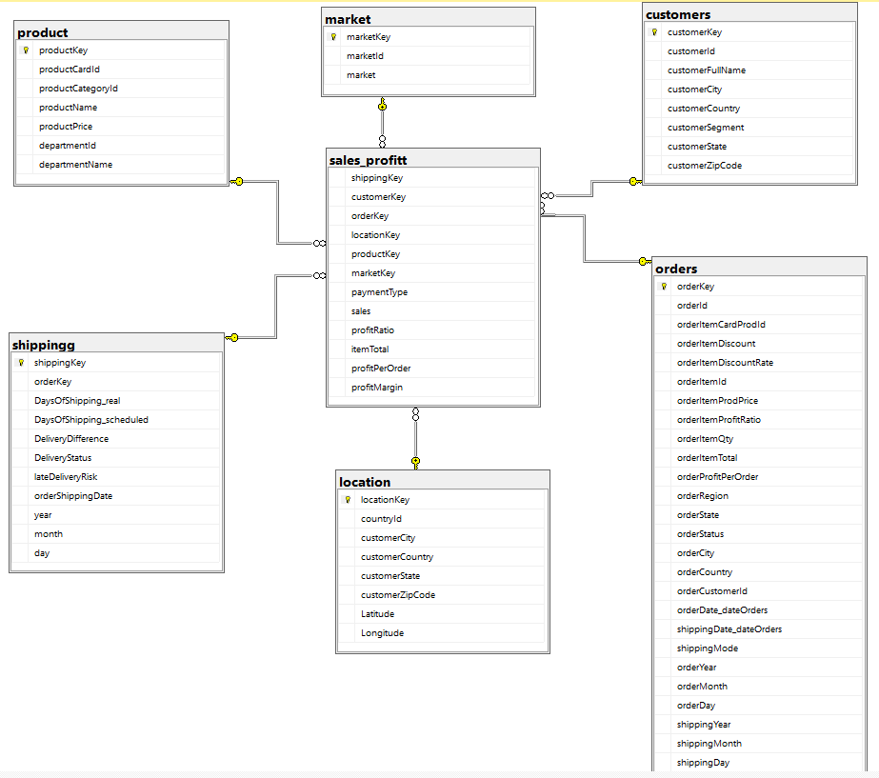
DB – Diagram

Slide 12
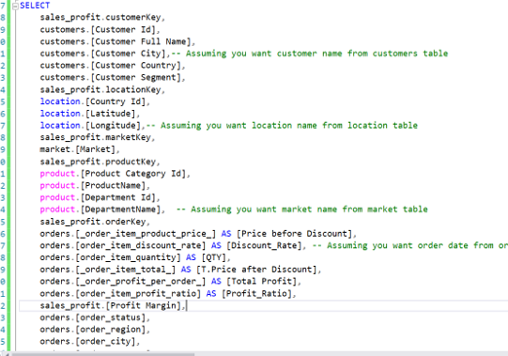
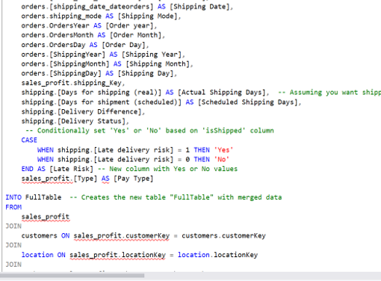
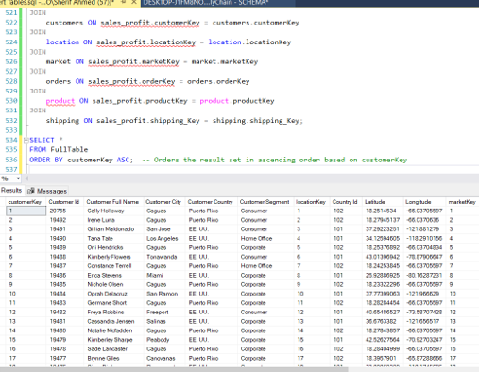
Database by SQL

Slide 13
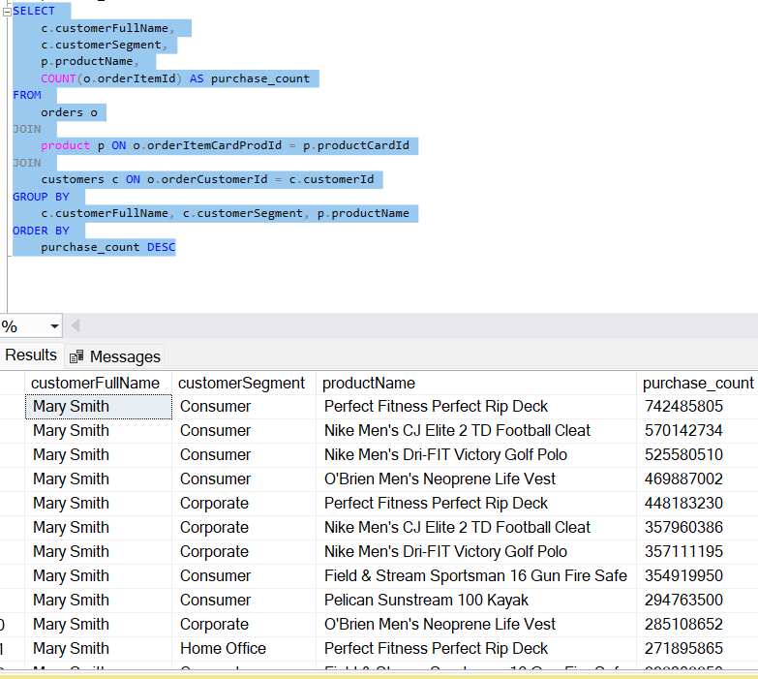
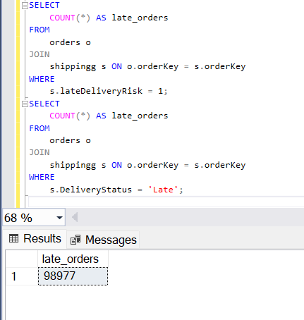
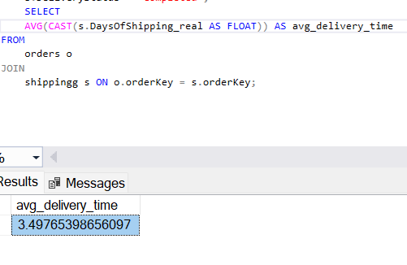
Data Analysis by SQL

Slide 14
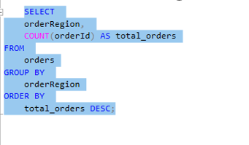
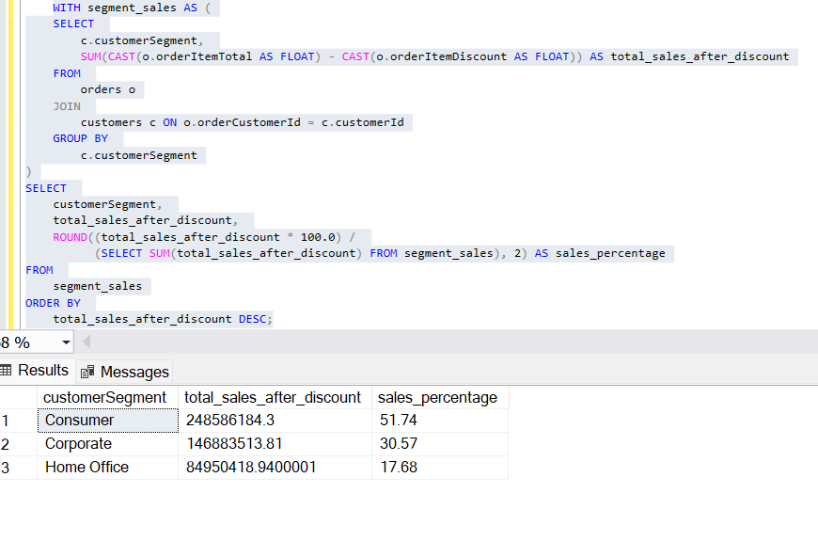
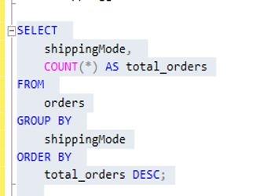
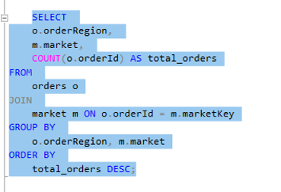
Data Analysis by SQL

Slide 15
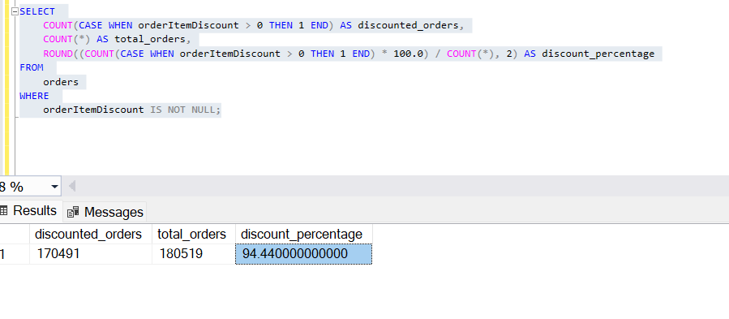
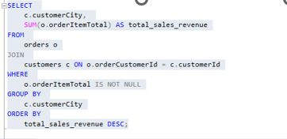
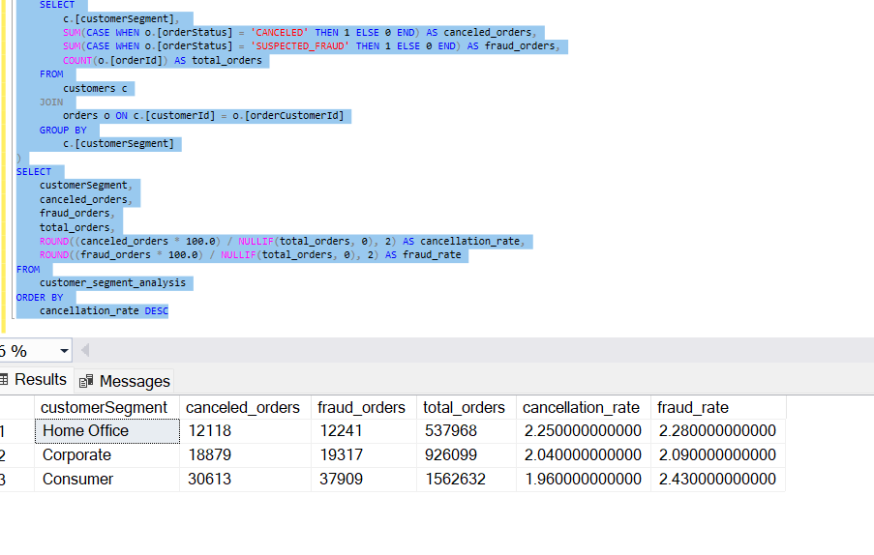
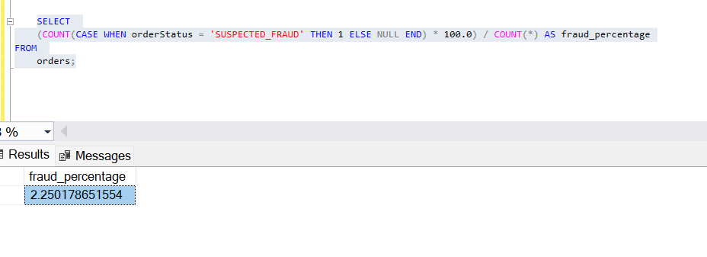
Data Analysis by SQL

Slide 16

Insights

Slide 17
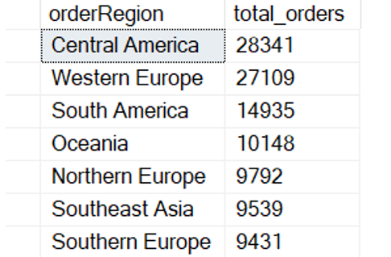
Insights
The consumer segment generates the highest total sales revenue.
The top 3 products that are most frequently purchased by customers are
Perfect Fitness Perfect Rip Deck – 74,248 units
Nike Men's CJ Elite 2 TD Football Cleat – 57,011 units
Nike Men's Dri-FIT Victory Golf Polo – 52,551 units
Average delivery time across all orders is 3.497 Days.
Orders by Region Top Regions are:
Central America has the highest total orders with 28,341 orders.
Western Europe follows closely with 27,109 orders.
South America holds the third position with 14,935 orders.

Slide 18
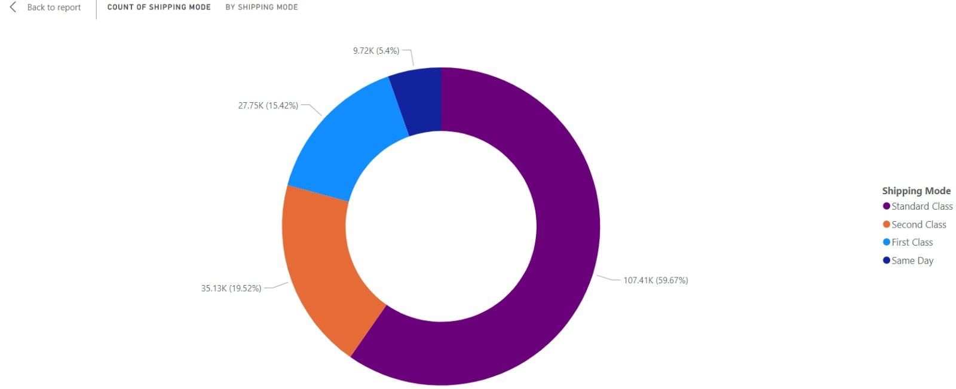
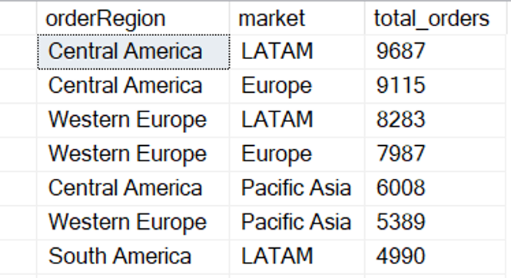
Insights
Market-Level Distribution:
In Central America, the most active markets are LATAM (9,687 orders) and Europe (9,115 orders).
Western Europe also serves multiple markets, with LATAM (8,283 orders) and Europe (7,987 orders) dominating.
South America shows a split between LATAM (4,990 orders) and Europe (4,974 orders) markets.
Most Common Shipping Modes Used
The most common shipping mode is Standard Class with 107,752 orders.
The least common shipping mode is Same Day with 9,737 orders.

Slide 19
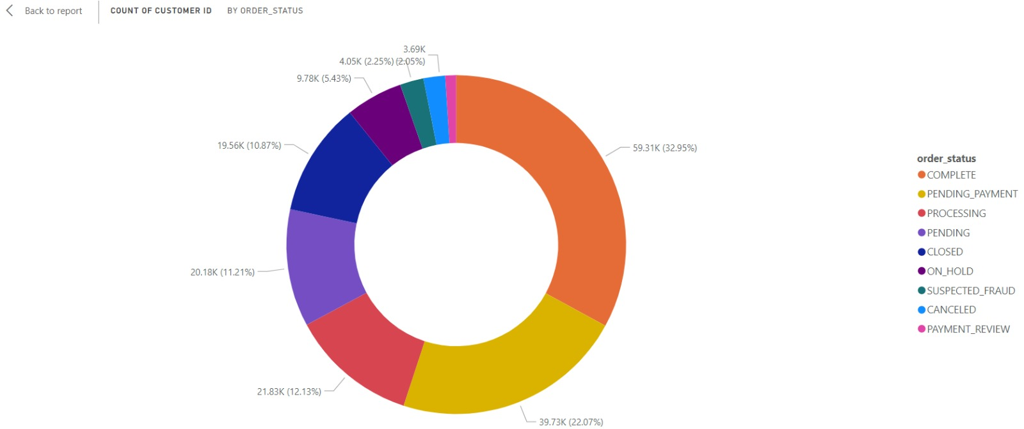
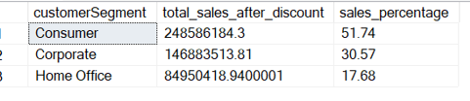
Insights
Top Customer Segments Contributing to Sales
Consumer segment contributes the most to sales, accounting for 51.74% of total sales after discount.
Corporate segment follows, contributing 30.57%.
Home Office segment has the smallest contribution with 17.68% of total sales.
2.25% of total orders were suspected of fraud.
Top Customer Cities by Sales Revenue
Caguas generates the highest total profit and stands out significantly among all cities.
Other leading cities include Chicago, Los Angeles, Brooklyn, and Bronx.

Slide 20
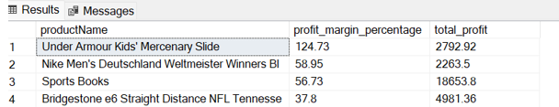
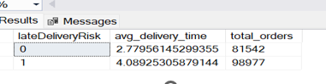
Insights
Relationship Between Delivery Time and Late Delivery Risk
Orders with late delivery risk have an average delivery time of 4.09 days.
In contrast, orders without late delivery risk are delivered faster, with an average delivery time of 2.78 days.
This indicates that longer delivery times are strongly associated with a higher risk of late deliveries.
The top product with the highest profit margin

Slide 21
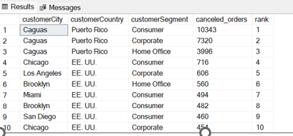
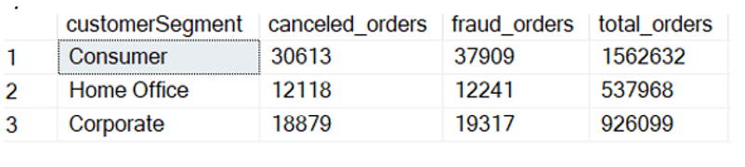
Insights
Customer Demographics Prone to Order Cancellations:
Impact of Customer Segmentation on Order Cancellation and Fraud Rates

Slide 22

Dashboard

Slide 23
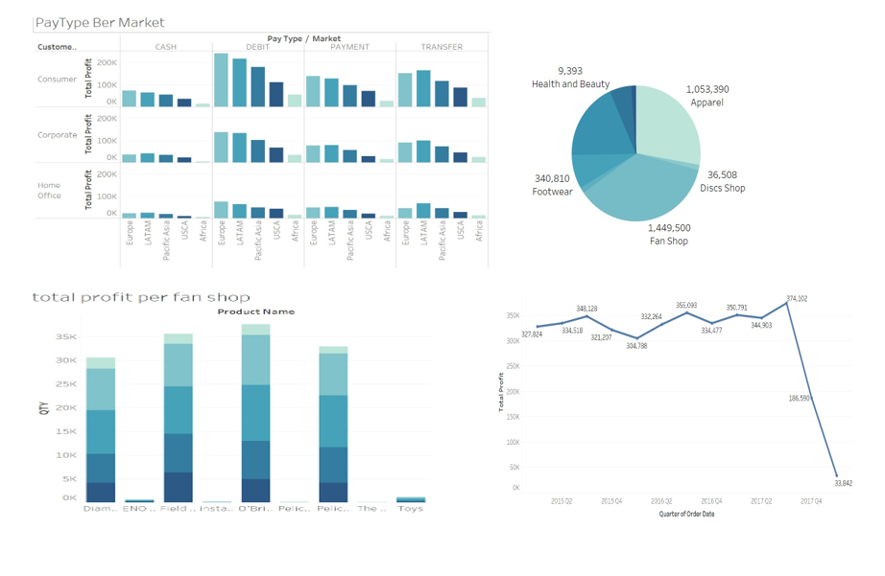

Slide 24
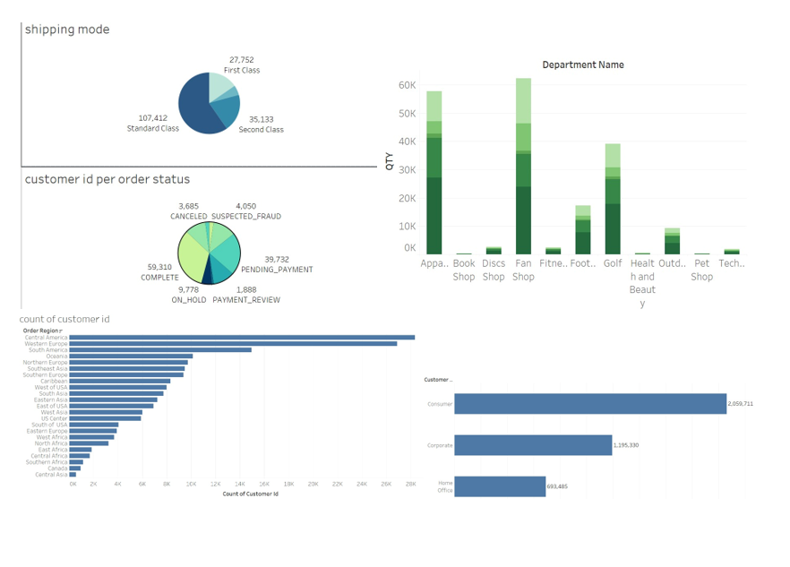

Slide 25
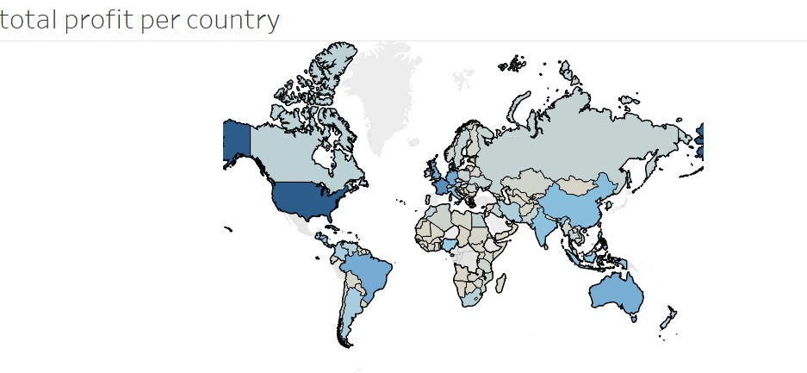

Slide 26
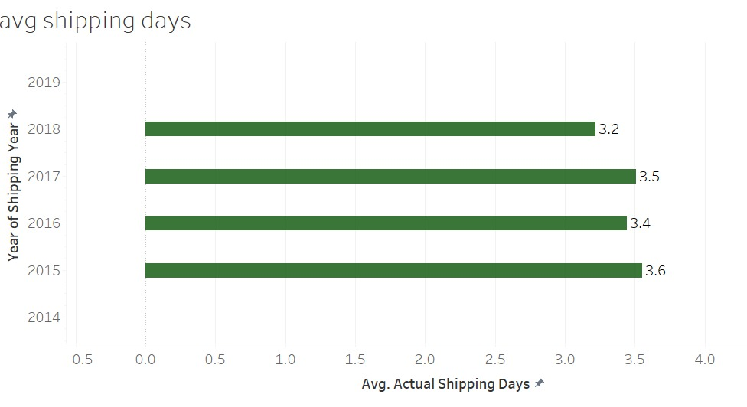
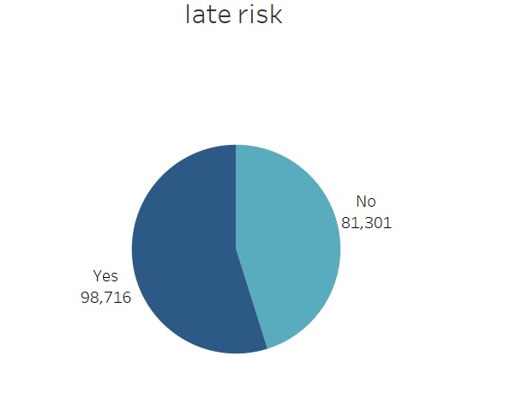

Slide 27
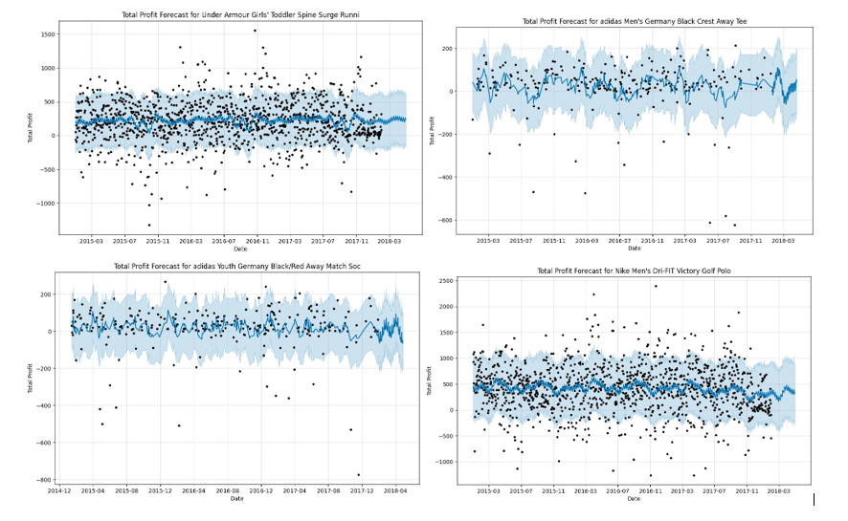
Forecasting
Profitability by product

Slide 28
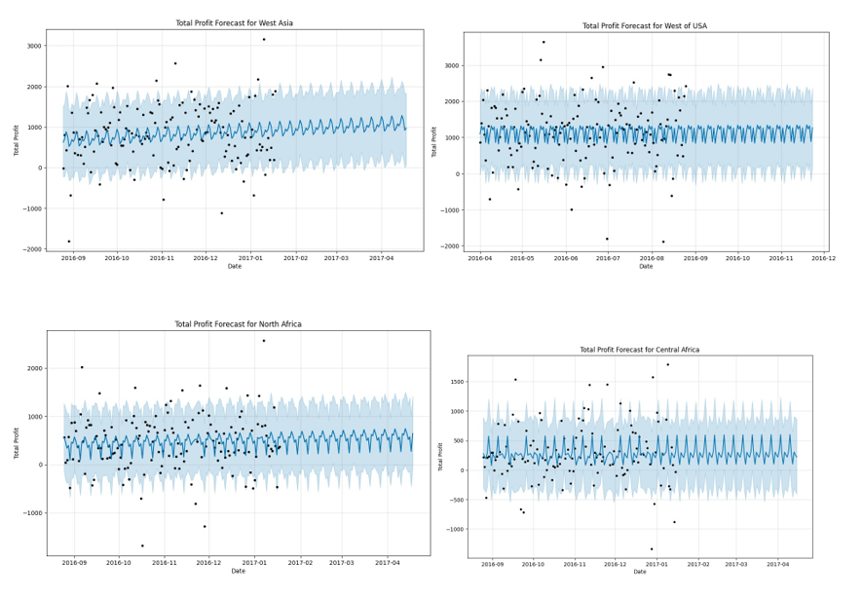
Forecasting
Profitability by Region

Slide 29
Thank You!

